Slide 1

AFP: Idiosyncratic Volatility Puzzle
Qiuyi Chen
Zirui Ding
Zongyi Gong
Jong-Myun Moon
Shihong Wen

Slide 2
Introduction

Slide 3
Idiosyncratic Volatility
Idiosyncratic Volatility (IVOL)
Stock return volatility not arising from systematic risk factors
IVOL can be defined relative to the Fama and French model (FF3)
Total Volatility (TVOL) = Factor Volatility + IVOL
IVOL and returns
If FF3 is correct, IVOL has no impact on expected returns
If FF3 is not correct, IVOL may capture unknown systematic factors

Slide 4
Idiosyncratic Volatility Puzzle
High IVOL → Low Average Return
Ang, Hodrick, Xing, and Zhang (2006)
“Stocks with high idiosyncratic volatility […] have abysmally low average return”
Low average return of high IVOL stocks → IVOL Puzzle
IVOL puzzle
Robust to controlling for several known anomalies
Value, size, liquidity, volume, disagreement, momentum
Difficult to rationalize
Statistical arbitrage
Shorting high IVOL and buying low IVOL
Statistical (risky) arbitrage with positive expected returns and zero cost

Slide 5
Two Candidate Explanations
Short-term speculation
Existence of short-term speculative trades
Short-term (daily) fluctuation reflects more noise than “fundamental” risk
Example: flash crash
Longer horizon volatility is perhaps a better measure
Main problem: how to define short-term and long-term volatility
We conjecture short-term volatility is NOT priced
Friction
IVOL puzzle → Statistical arbitrage
Why IVOL puzzle persists? Friction?
We consider (i) transaction cost and (ii) short-sell fee
Short-sell fee: data available
Transaction cost: no data / use conservative estimates

Slide 6
OUTLINE
Short-term IVOL
Long-term IVOL
Short- and Long-term IVOL: Double Sorting
Frictions
Transaction cost
Short sale cost
Robustness
Size / Reversal / Beta
Conclusion

Slide 7
Short term volatility puzzle

Slide 8
Short Term Volatility
Total Volatility:
: Sample standard deviation estimated of using daily returns of the last month
Idiosyncratic Volatility:
: Sample standard deviation estimated of using residual returns of the last month

Slide 9
Quintile Portfolio Construction
Sort Stocks According to Last Month’s Volatility
Form five value-weighted quintile portfolios
Measure holding period return of the portfolios next month
Monthly
Rebalancing

Slide 10
Puzzle Effect from 1965 to 2016
Higher Total or Idiosyncratic Volatility, Lower alpha
Higher Volatility, Smaller the stock
Large, Negative Returns of Quintile 5 drives the puzzle

Slide 11
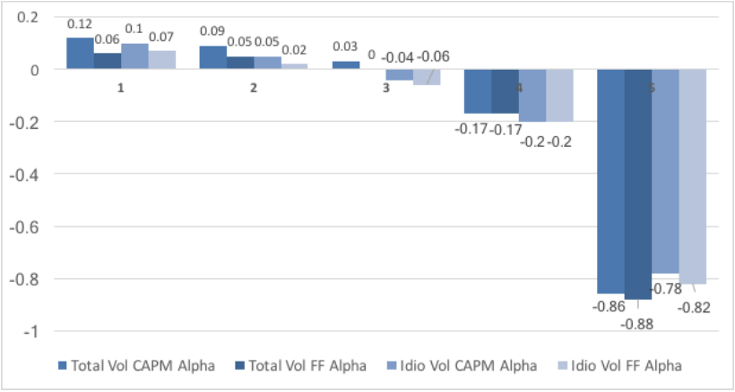
FF-3 Alphas for Quintile Portfolios
( Rank1: Lowest Volatility ~ 5: Highest Volatility)

Slide 12
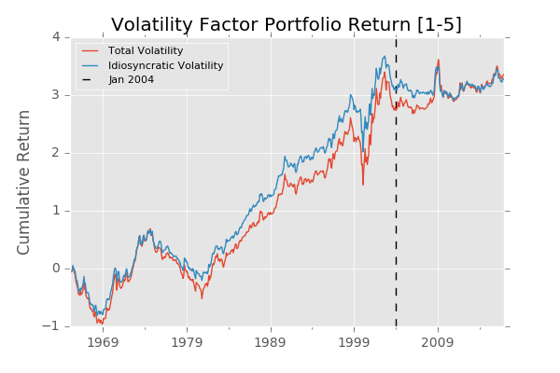
Volatility Factor Returns
Long-Short Factor Portfolio:
Go long the lowest volatility quintile and short the highest volatility quintile

Slide 13
Time-Specific Puzzle Effect

Slide 14
Long-term volatility

Slide 15
Long-term Volatility
IVOL: Residual volatility from FF3 regression
Ang et al. use daily returns over a short horizon (one month)
Short-term IVOL: One-month IVOL with daily returns
Long-term IVOL: 24-month IVOL with monthly returns
Conjecture: IVOL puzzle may vanish with long-term IVOL
Our intuition: day traders and fundamental investors
Day Traders (DT): driven by sentiment / short horizon
Fundamental investors (FI): driven by fundamental risk and return / longer horizon
DT cares less about risk (short-term IVOL)

Slide 16
24-month TVOL sorting
Rank | Mean | Std Dev. | % Mkt Share | CAPM Alpha | FF-3 Alpha
1 | 0.888 | 3.7 | 41.6% | 0.12 | 0.08
 |  |  |  | [1.77] | [1.64]
2 | 0.930 | 4.9 | 25.7% | 0.01 | -0.03
 |  |  |  | [0.24] | [-0.65]
3 | 0.967 | 6.0 | 19.3% | -0.05 | -0.04
 |  |  |  | [-0.59] | [-0.48]
4 | 0.927 | 7.3 | 8.9% | -0.19 | -0.16
 |  |  |  | [-1.17] | [-1.26]
5 | 0.675 | 8.9 | 4.6% | -0.55 | -0.50
 |  |  |  | [-2.40] | [-3.28]
5-1 | -0.213 |  |  | -0.67 | -0.58
 | [-0.667] |  |  | [-2.34] | [-3.03]
Quintile portfolios sorted by 24-month TVOL
At the beginning of month t, form a new portfolio
Based on 24-month TVOL from month t-25 to t-1
No overlapping period with short-term VOL portfolios
Higher TVOL → Lower Alpha
Notes:
TVOL incudes the systematic risk and idio risk
Hence not surprising to see lower return

Slide 17
24-month IVOL sorting
Rank | Mean | Std Dev. | % Mkt Share | CAPM Alpha | FF-3 Alpha
1 | 0.913 | 4.0 | 41.7% | 0.10 | 0.06
 |  |  |  | [1.78] | [1.39]
2 | 0.899 | 4.6 | 28.8% | 0.01 | -0.01
 |  |  |  | [0.27] | [-0.14]
3 | 0.913 | 5.6 | 18.3% | 0.07 | -0.05
 |  |  |  | [-0.87] | [-0.77]
4 | 0.939 | 6.7 | 7.6% | -0.13 | -0.09
 |  |  |  | [-0.88] | [-0.81]
5 | 0.776 | 8.4 | 3.7% | -0.40 | -0.33
 |  |  |  | [-1.89] | [-2.24]
5-1 | -0.137 |  |  | -0.50 | -0.39
 | [-0.48] |  |  | [-1.96] | [-2.22]
Quintile portfolios sorted by 24-month IVOL
At the beginning of month t, form a new portfolio
Based on 24-month IVOL from month t-25 to t-1
Higher IVOL → Lower Alpha
IVOL puzzle persists
Notes:
IVOL. We do not see long-term ivol solves the problem.

Slide 18
Long-term IVOL FF-3 Alphas
Sample Period (months) | Ret Freq | IVOL Ranking
 |  | 1 Low | 2 | 3 | 4 | 5 High | 5-1
12 | Monthly | 0.04 | -0.02 | -0.03 | -0.13 | -0.20 | -0.24
 |  | [0.84] | [-0.54] | [-0.55] | [-1.25] | [-1.44] | [-1.43]
18 | Monthly | 0.03 | 0.00 | -0.04 | -0.09 | -0.38 | -0.41
 |  | [0.87] | [0.06] | [-0.66] | [-0.76] | [-2.55] | [-2.42]
24 | Monthly | 0.06 | -0.01 | -0.05 | -0.09 | -0.33 | -0.39
 |  | [1.39] | [-0.14] | [-0.77] | [-0.81] | [-2.24] | [-2.22]
No observable relation between time horizon and IVOL alphas
However, long-term IVOL is not orthogonal to short-term IVOL
We need to disentangle the relationship

Slide 19
Double sort

Slide 20
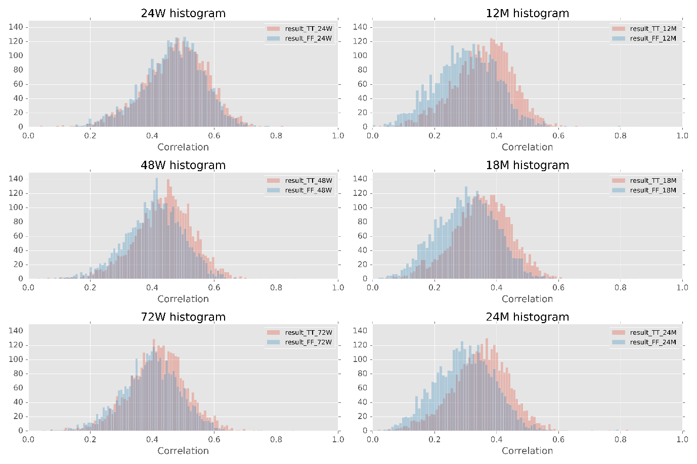
Long-term vs. short-term Volatility
Frequency
Time horizon
Idiosyncratic vs. total
Notes:
As shown in the previous two sections, the quintile portfolios constructed by sorting long term volatility show similar patterns of performance to those constructed by sorting short term volatility, though with less alpha spread. One natural explanation is that short term and long term volatilities are highly correlated.
To test this hypothesis, we calculate the cross-sectional correlation between short term and long term volatilities for each month since 1965.
The following histogram plots the distribution of correlations between short term volatility and the 6 long term volatilities.
Generally, correlations are positive with only a few outliers. We observe three noticeable patterns:
long term volatilities calculated with higher frequency (weekly) returns has higher correlation with short-term volatilities than that calculated with lower frequency (monthly) returns. This is expected since short term volatility is calculated with daily returns. Long-term return of higher frequency should share more similarities with short-term return.
for long-term volatility calculated with monthly returns, the correlation between short-term total volatility and long-term total volatility is noticeably higher than that between short-term idiosyncratic volatility and long-term idiosyncratic volatility. Total volatility includes variances of other FF risk factors which daily return and monthly return have in common, whereas idiosyncratic volatility excludes the factor-induced common variation so that the correlation between daily and monthly returns should be reduced. We find this reduction of correlation for long-term volatility calculated using weekly returns, but with much smaller magnitude. The observations are in line with the summary statistics in Table 5‑1. The large t-statistics indicate that the correlation between total long term and short term volatilities is unlikely to be the same as that of idiosyncratic volatilities.
for weekly returns, compared to that of 24-week sample period, the whole distributions of 48-week and 72-week sample period shift towards the lower end. The reason why this shift happens is worth further investigation. By contrast, the distributions calculated with monthly returns are relatively stable across different sample periods.

Slide 21
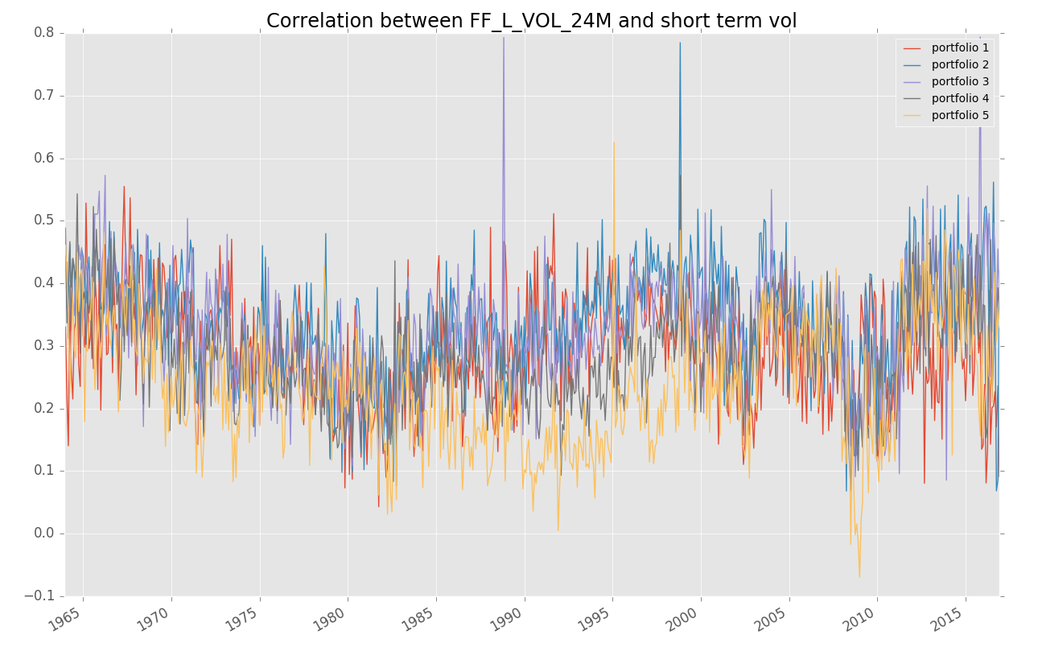
Long-term vs. short-term volatility – cont’d
Correlation time series: short-term volatility and 24-month volatility
Notes:
Over time, the correlations fluctuate within a range of -0.1 to 0.6. During normal times, we expect a stable relationship between long-term and short-term volatilities resulting from the mean-reverting nature of daily returns. During crisis times, this relationship may break down in the sense that the short-term volatility could surge temporally whereas long-term volatility still stay relative insensitive to the drastic change of the nearest market condition. We observe this phenomenon around 2008 financial crisis when the correlation plunged.

Slide 22
Double Sort - I
Average number of stocks in each double-sort category from 1965 Feb to 2016 Dec based on short-term and 24-month IVOL
Notes:
The results in the previous section prove that, though not perfectly correlated, there is positive and non-negligible correlation between long term and short term volatility. Next, we would like to investigate how long term and short term volatilities interact in the puzzle.
We double-sort stocks monthly according to their historical short-term and long-term volatilities (based on total or idiosyncratic risk). We then form 5 x 5 quintile value-weighted portfolios and calculate their holding period returns next month.
Table 5‑2 records the average number of stocks within each double-sort category. Since long term and short term volatilities are positively correlated, most of the observations are concentrated around the diagonal and the matrix is roughly symmetric.

Slide 23
Double Sort - II
Average FF-3 alpha and t-statistics for each category and 5th – 1st quintile portfolio from 1965 Feb to 2016 Dec based on short-term and 24-month IVOL
Negative and significant [Hi – Lo] alpha conditional on any long-term volatility level
Insignificant [Hi – Lo] alpha conditional on any short-term volatility level
Long-term vol puzzle is driven by short-term vol
Notes:
In the previous sections, we find that volatility puzzle exists for both long-term measure and short-term measure, unconditioned on each other. We run FF regression on the monthly returns of each portfolio to obtain their FF-3 alphas. All results are calculated based on 24-month long term volatility of monthly returns and 1-month short term volatility of daily returns. Here we focus on idiosyncratic returns and total returns shows similar patterns,.
Here we observe that short term puzzle persists regardless which long-term volatility quintile it is conditioned on, meaning for each row in Table 5‑4, as short-term total or idiosyncratic volatility increases, FF-3 alpha for [5-1] portfolio of short-term volatility decreases. Alpha consistently changes from slightly positive or near zero to significantly negative when entering to the highest short-term volatility quintile, with robust t-statistics for each long-term category. This pattern is similar to those observed in the single sorting results.
However, we cease to observe the existence of long-term volatility puzzle conditioned on short-term volatility. For each short-term category, the alpha spread ([Hi – Lo] or [5 - 1] in the previous sections) of quintile portfolio sorted by their long-term volatilities is not significantly different from zero.
In fact, within the two lowest short-term volatility quintiles, driven by the large positive alphas (with relatively high t-statistics but still smaller than 2) of the portfolios with the highest long-term volatility, the alpha spreads are even slightly positive, coinciding with a normal expectation that higher long term volatilities should be rewarded with higher returns.
Moving from the lowest short-term volatility quintile to the highest short-term volatility quintile, long term alpha spread changes from positive to negative. We do not intend to over-interpret the above observations as the t-statistics for the first four short-term quintiles are not high enough to redeem any robust conclusions. But we feel it is still worth pointing out the trend.

Slide 24
Double Sort - III
Why we see long-term volatility puzzle in single – sort?
Weighted average returns of each row equals to long – term volatility single sort result
Weightings are concentrated on upper left and bottom right corner
Table: Percentage of market capitalization in each double-sort category from 1965 Feb to 2016 Dec based on short-term and 24-month IVOL

Slide 25
Market Frictions and Anomaly
Notes:
As we see in the previous section, the long-term puzzle is driven by short-term volatility puzzle. In this section, we would like to analyze from the angle of market frictions. go more deeply to understand why short-term volatility puzzle exists, why it persists before 2004, and why it diminishes after 2004.

Slide 26
Market Frictions and Anomaly
Before 2004?
After 2004?
Notes:
This is the volatility factor portfolio return.
So, our first question is why short-term volatility factor portfolio generates such a high return before 2004? Our hypothesis is that stocks with high volatility have higher disagreement. Under short sale constraints, only the optimistic view can be expressed. Thus, the stocks would be overpriced. The key point here is the short sell constraints.
Our second question is why the return of the factor portfolio diminishes after 2004? One possibility is that the abnormal return is arbitraged away.
Another possibility is that people don’t chase after high volatility that much.

Slide 27
Market Frictions and Anomaly
Period | Jan 1980 to Dec 2003 | Jan 2004 to Dec 2016
Panel A: Return of [1-5] Portfolio constructed based on 1-month daily total volatility
Mean % | 1.06 [2.33] | 0.35 [0.92]
FF3 alpha % | 1.17 [3.88] | 0.94 [4.50]
Panel B: Return of [1-5] Portfolio constructed based on 1-month daily idiosyncratic volatility
Mean % | 1.11 [2.80] | 0.09 [0.28]
FF3 alpha % | 1.25 [4.57] | 0.51 [[2.29]
Panel C: Excess return on market
Mean % | 0.64 (2.47) | 0.63 (1.67)
Notes:
As we see in the table, not only return of the factor portfolio decreases. The alpha of the factor portfolio also decreases after 2004.

Slide 28
Market Frictions and Anomaly
Measuring market frictions
1. Short Sale Fees
Indicative Fees from WRDS (available after 2002)
2. Transaction Costs
Turnover rate times a fixed cost
Turnover rate = sum of absolute weight changes at month end
Fixed cost ranges from 40 bps to 200 bps
Notes:
We use two measurements for market frictions, one is short sale fees, another is transaction cost.
We use the indicative short fee on WRDS (Markit database) as a proxy of short constraint level. Indicative short fee is defined as the difference between Fed Fund Rate and indicative short rebate.
We calculate the short sale fee of a portfolio as the weighted average of the short fees on individual stocks.
Transaction cost is calculated as the turnover rate times the fixed cost.
We estimate the fixed cost based on both market practitioner views and academic research, which ranges from 40 bps to 200 bps.
we do not aim to provide an accurate calculation of transaction costs. Instead, we would like to provide a conservative, yet sensible estimate to assess the impact of market friction on factor portfolio return.

Slide 29
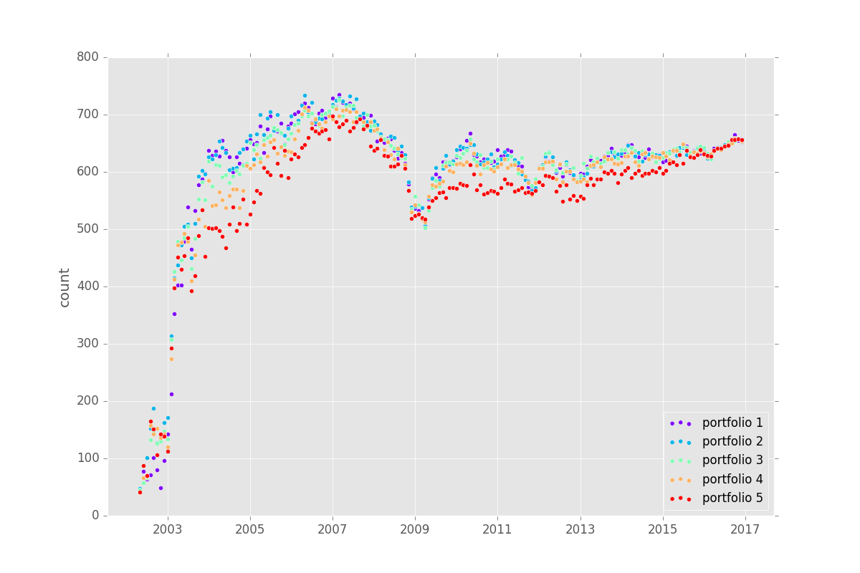
Market Frictions and Anomaly
Number of stocks with short fee data available in Markit Database for each portfolio
Notes:
Let’s go more details into the short sales data first.
For the number of stocks with short fees data, we observe that
Before 2004, the number of stocks whose short fee data are available is limited. This is because the database was still under construction.
Also, we observe a sharp dip of the number around 2008. This is because of the SEC short ban.
In general, the 5th quintile portfolio has the smallest number of available stocks. This might resufrom either more missing data or more stocks ineligible to short (infinity short fee). If the former, the sample size is still reasonably large to provide an accurate estimate of the average short fee. If the latter, it further proves that the stocks in portfolio 5 is harder to short than others.

Slide 30
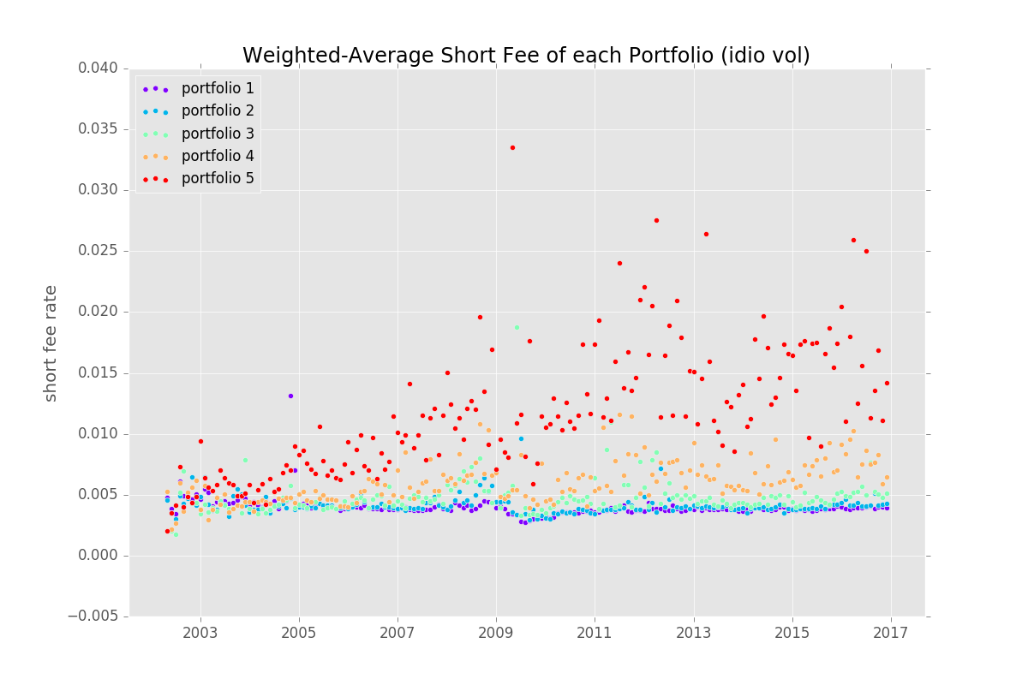
Market Frictions and Anomaly
Weighted average short fees of portfolios
Notes:
For each portfolio, we use the stock level data to calculate the weighted average short fee.
We observe that after 2004, the average short fee level for a portfolio is consistent with its volatility ranking. Particularly, the highest volatility quintile has the highest average short fee. What does it mean? It means that high volatility stocks are indeed most constrained by short sales. It supports our first hypothesis that high volatility stocks are overpriced due to short constraints.
The fee for the 5th quintle follows an upper trend before 2009 and stays relatively high in the same level, the reason for which is unclear.

Slide 31
Market Frictions and Anomaly
Average turnover rate for each portfolio
Portfolio Turnover Rate | 1-Month Total Volatility | 1-Month Idiosyncratic
1 | 76% | 60%
2 | 122% | 130%
3 | 142% | 147%
4 | 146% | 152%
5 | 135% | 141%
Notes:
Once we know that short constraint is an important reason for the volatility puzzle coming into existence. We are going to investigate whether this abnormal return can be arbitraged in practice, and whether the diminishing factor return is due to arbitrage.
We first look at the average turnover rate for each portfolio. We observe that the 5th portfolio with the highest volatility has the highest turnover rate, which potentially leads to higher transaction costs.

Slide 32
Market Frictions and Anomaly
Summary for [1-5] return based on 1-month idio vol after transaction cost
Return of [1-5] Portfolio constructed based on 1-month daily idiosyncratic volatility After transaction cost (1965 Feb to 2016 Dec)
Transaction Cost One Way (bps) | 0 | 40 | 80 | 200 | Threshold Cost
Arithmetic Mean (%) | 0.53 | -0.28 | -1.08 | -3.5 | 0.26
t-stat | 1.89 | -1.00 | -3.87 | -12.25
CAPM alpha (%) | 0.88 | 0.08 | -0.73 | -3.14 | 0.44
t-stat | 3.60 | 0.31 | -2.96 | -12.57
FF-3 alpha (%) | 0.89 | 0.09 | -0.72 | -3.14 | 0.44
t-stat | 5.42 | 0.52 | -4.30 | -17.80
Notes:
Then, we quantify our intuition of the impact of transaction cost. We measure the performance of factor portfolio for idiosyncratic volatility after transaction costs.
We test the return with transaction cost from 0 to 200 bps. The threshold cost is the cost to make the return / alpha zero.
Firstly, the threshold cost to make arithmetic mean return breakeven is only 26 bps. It doesn’t even reach the lower bound of our transaction cost estimate of 40 bps.
Secondly, we observe that CAPM and FF-3 alphas can tolerate higher transaction cost up to around 40 ~ 50 bps. To capture that, we need to hedge the risk from market factor or FF-3 factors, which can be costly.
Either way, [1-5] portfolio barely provides satisfactory post transaction cost returns.

Slide 33
Market Frictions and Anomaly
[1-5] return based on 1-month idio vol after transaction cost and short fees
Return of [1-5] Portfolio constructed based on 1-month daily idiosyncratic volatility After transaction cost and short fee (2004 Jan to 2016 Dec)
Transaction Cost One Way (bps) | 0 | 40 | 80 | 200 | Threshold Cost
Arithmetic Mean (%) | -0.03 | -0.88 | -1.73 | -4.28 | -0.02
t-stat | -0.10 | -2.91 | -5.73 | -14.21
CAPM alpha (%) | 0.39 | -0.46 | -1.31 | -3.86 | 0.18
t-stat | 1.66 | -1.92 | -5.50 | -16.13
FF-3 alpha (%) | 0.39 | -0.46 | -1.31 | -3.86 | 0.18
t-stat | 1.79 | -2.11 | -5.97 | -17.29
Notes:
We then add the short selling fees and test the return from 2004 to 2016. We observe the IVOL factor return is already negative when transaction is zero. This is due to first decreasing spread after 2004 and second the inclusion of short sale fees.

Slide 34
Market Frictions and Anomaly
Would that be profitable if we use long-term volatility as signals?
Portfolio Turnover Rate | 1-Month Total Volatility | 1-Month Idiosyncratic | 24-Month Total Volatility | 24-Month Idiosyncratic
1 | 76% | 60% | 10% | 20%
2 | 122% | 130% | 27% | 48%
3 | 142% | 147% | 32% | 51%
4 | 146% | 152% | 32% | 45%
5 | 135% | 141% | 24% | 31%
Notes:
One of the reasons we investigate long term volatility is that long term volatility could potentially be a more persistent alpha signal than short term volatility, thus requires less turnover for trading on it. We did the same profitability analysis on long term volatility signal.

Slide 35
Market Frictions and Anomaly
Summary for [1-5] return based on 24-month idio vol after transaction cost
Return of [1-5] Portfolio constructed based on 24-month monthly idiosyncratic volatility After transaction cost (1965 Feb to 2016 Dec)
Transaction Cost One Way (bps) | 0 | 40 | 80 | 200 | Threshold Cost
Arithmetic Mean (%) | 0.14 | -0.07 | -0.27 | -0.88 | 0.27
t-stat | 0.48 | -0.23 | -0.96 | -3.18
CAPM alpha (%) | 0.5 | 0.29 | 0.09 | -0.52 | 0.97
t-stat | 1.96 | 1.16 | 0.35 | -2.02
FF-3 alpha (%) | 0.39 | 0.19 | -0.02 | -0.63 | 0.77
t-stat | 2.22 | 1.07 | -0.09 | -3.43
Notes:
As we see, with lower turnover, the threshold cost is actually higher for long term volatility. But it still doesn’t meet the lower bound of our estimation. This could be due to that the spread for long-term volatility is too low to make it profitable.

Slide 36
Market Frictions and Anomaly
[1-5] return based on 24-month idio vol after transaction cost and short fees
Panel B: Return of [1-5] Portfolio constructed based on 24-month idiosyncratic volatility After transaction cost and short fee (2004 Jan to 2016 Dec)
Transaction Cost One Way (bps) | 0 | 40 | 80 | 200 | Threshold Cost
Arithmetic Mean (%) | -0.09 | -0.26 | -0.42 | -0.92 | -0.22
t-stat | -0.29 | -0.84 | -1.39 | -2.97
CAPM alpha (%) | 0.27 | 0.1 | -0.07 | -0.58 | 0.64
t-stat | 0.95 | 0.34 | -0.24 | -1.81
FF-3 alpha (%) | 0.27 | 0.1 | -0.07 | -0.58 | 0.64
t-stat | 1.07 | 0.40 | -0.27 | -2.11
Notes:
After adding short sales cost, the return turns negative even if we assume transaction cost is zero.

Slide 37
Market Frictions and Anomaly
Summary
Limit of arbitrage
Less demand for high volatility stocks:
Changing preference of investors?
Notes:
To conclude, turnover rate and market friction (transaction cost + short fee) are too high to allow the long-short portfolio profitable.
One thing to notice is that even if trading on volatility factor portfolio were profitable, the strategy would entail a lot of liquidity risk. Because it requires shorting the most illiquid and highly volatile stocks. The tail risk plus margin call could easily wipe out investors’ position.
Thus, it is impractical to execute the arbitrage both before 2004 and after 2004. This limit of arbitrage explains the persistence of the volatility anomaly.
The conclusion here also helps us to understand the diminishment of positive return of the short-term volatility factor after 2004.
Since the market friction is so high, it is unlikely that the abnormal return of volatility factor is arbitraged away. Thus, the second explanation that there is less demand for high volatility stocks seems more plausible.
## People may simply value the low volatility stocks more and avoid the high volatility stocks much less upon the discovery of the puzzle.

Slide 38
Robustness Check

Slide 39
Robustness Check
Short-term volatility puzzle is correlated with other risk factors such as size and the market
We test whether short-term volatility puzzle is genuine by controlling the effect of other risk factors:
Size
Beta
Return Reversion

Slide 40
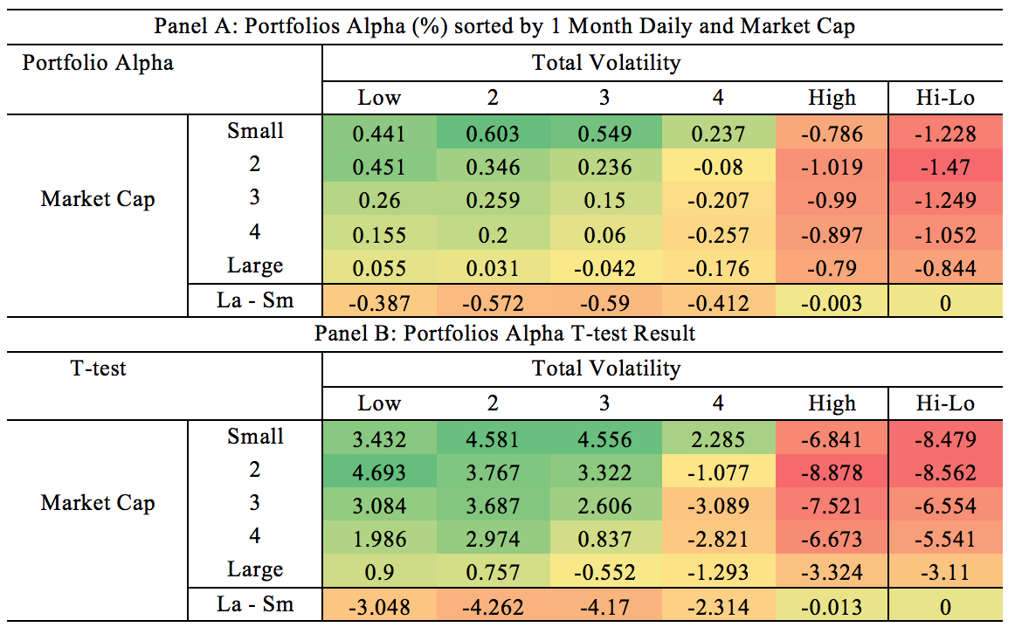
Size
For all size quintiles, the alpha spread [Hi-Lo] induced by the spread in short-term volatility is negative
Robust t-statistics

Slide 41
Size
Decreasing alpha with increasing volatility when size is controlled
Look at each column, we also observe “size effect” for portfolios of similar volatility

Slide 42
Size
The magnitude of negative alpha for the portfolios with the highest volatilities is stable with no obvious pattern
The different between smallest market cap and biggest market cap is insignificant

Slide 43
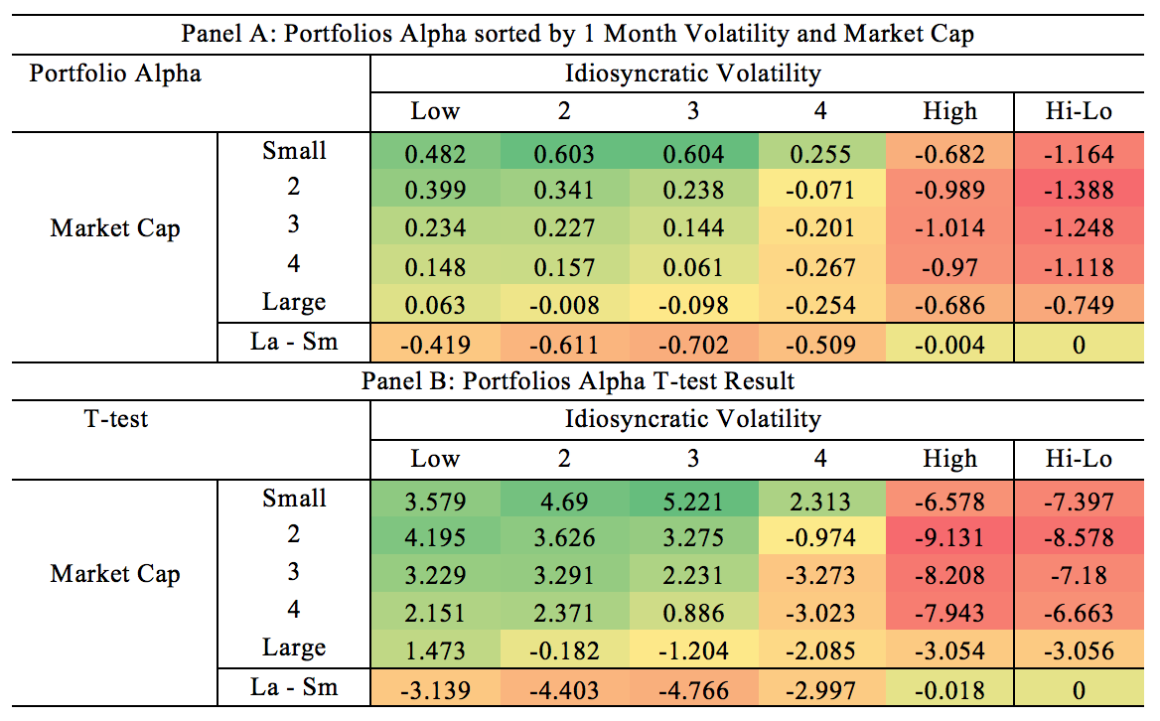
Size
Reduction in alpha with increase in volatility
Significant alpha for all [Hi-Lo] portfolios and high volatility portfolios when controlling size
Insignificant alpha different between lowest and highest alpha

Slide 44
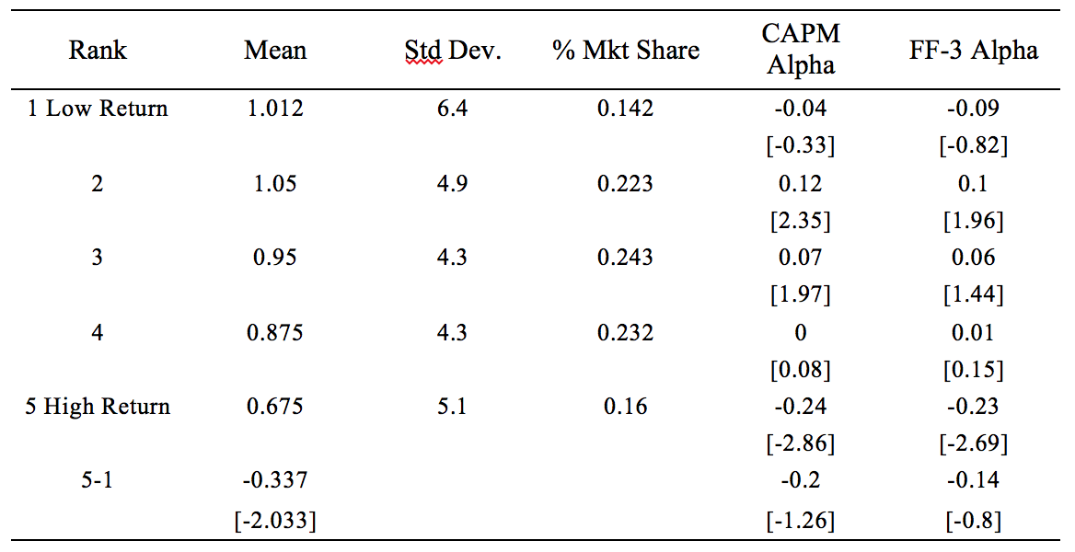
Return Reversal
Stock market exhibits short-term mean reversal reversion

Slide 45
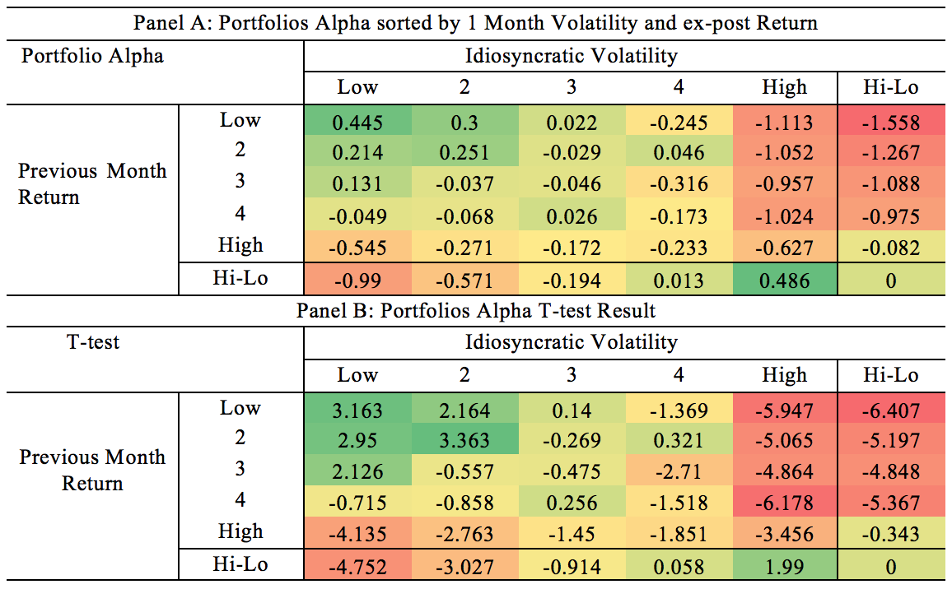
Return Reversal
Volatility puzzle still can be observed within each quintile portfolio, except for the highest return quintile

Slide 46
Return Reversal
The portfolio return moves from short-term mean reversal to short-term momentum
Short-term reversal effect is largely reduced for portfolios in the third and fourth quintiles

Slide 47
Return Reversal
We also observe:
significant positive alphas for portfolios with low volatility and low past month return
Significant negative alphas for portfolios with high volatility

Slide 48
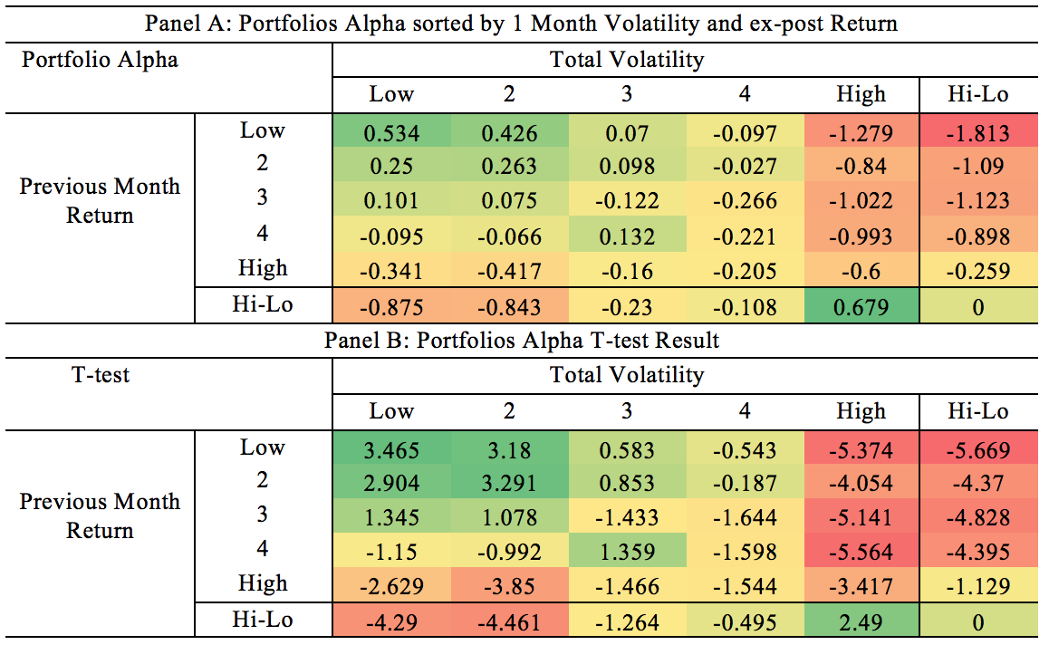
Return Reversal
Significant negative alphas for high volatility portfolios and Hi-Lo
Clear shift from mean reversal to momentum when volatility increase

Slide 49
Beta
Stock with high beta have low alpha
Our result:
Unadjusted portfolio returns are inversely related to betas

Slide 50
Beta
We don’t observe consistent beta effect across all volatilities quintiles

Slide 51
Beta
For different beta quintiles, the alpha spreads are all significantly negative except the one with the second lowest beta
The spread is particularly wide (-1.119) for the highest beta quintile

Slide 52
Beta
The alpha spread for beta is significantly negative across all five idiosyncratic volatility
This is because the idiosyncratic volatility portfolios are constructed after getting rid of the influence of the market factor

Slide 53
Beta
The alpha spread is significant conditional on 1st, 3rd and 5th beta quintiles.
Highest volatility portfolio has lowest alpha (-0.635), but smaller than what we observed when rank by total volatility (-1.119).
The alpha spread for total volatility might be enhanced by its positive correlation with beta
Notes:
Beta effect, control vol
Volatility effect, control beta

Slide 54
Beta
Since total volatility is related to market risk, it is not as good as idiosyncratic volatility when studying the relationship between volatility puzzle and beta anomaly
Beta anomaly is persistent across different idiosyncratic volatility
Volatility puzzle is influenced by the level of beta

Slide 55
Thank you!
Questions?

